Slide 1
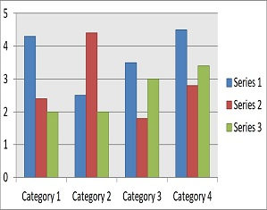
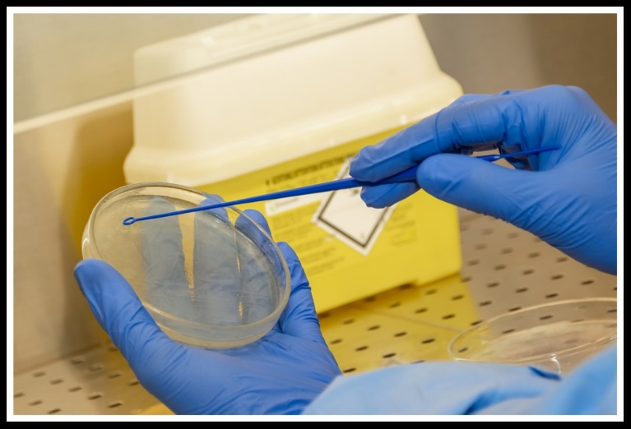
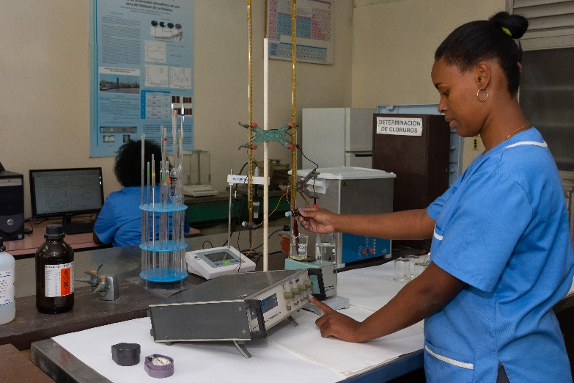
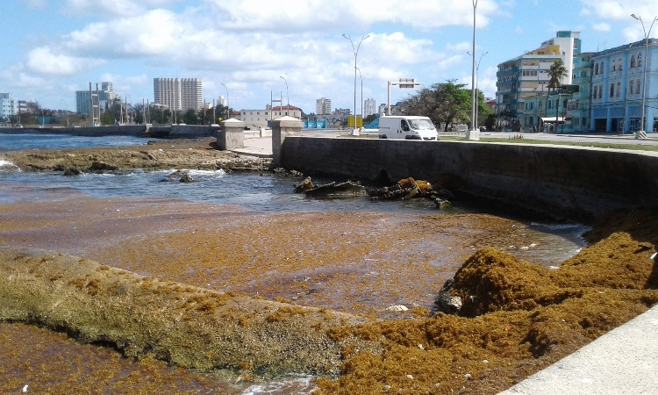
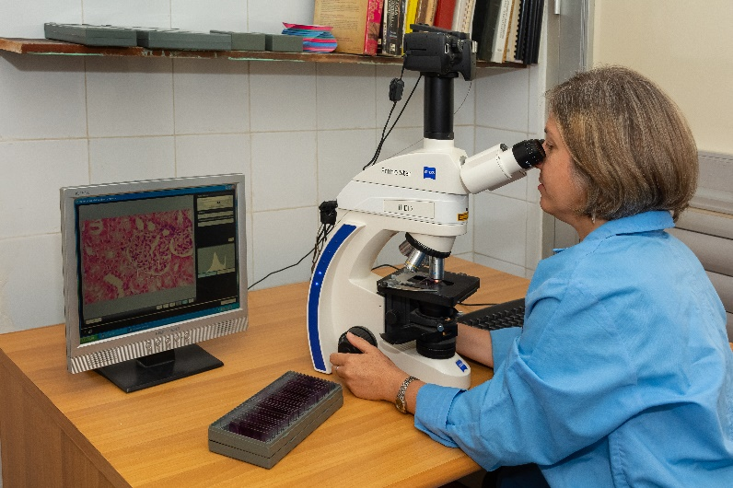
INTRODUCTION
RESULTS
CONCLUSIONS
Click here to insert your Results text. Type it in or copy and paste from your Word document or other source.
Speaking of Results, yours will look better if you remember to run a spell-check on your poster! After you’ve added your content click on Review, Spelling, or press F7.
To change the font style of this text box: Click the border once to highlight the entire text box, then select a different font or font size that works best for you. This text is Lato 24pt and is easily read up to 6 feet away.
Click here to insert your Conclusions text. Type it in or copy and paste from your Word document or other source.
This text box will automatically re-size to your text. To turn off that feature, right click inside this box and go to Format Shape, Text Box, Autofit, and select the “Do Not Autofit” radio button.
To change the font style of this text box: Click the border once to highlight the entire text box, then select a different font or font size that works best for you. This text is Lato 24pt and is easily read up to 6 feet away.
CNIC ProNat has provided this template to help prepare the electronic poster. Dimensions are set at 21" tall by 45" wide (half scale)
Click here to insert your Introduction text. Write it down or copy and paste from your Word document or other source.
This text box will automatically resize your text. To disable that feature, right-click inside this box and go to Format Shape, Text Box, AutoFit and select the "Don't AutoFit" radio button.
To change the font style of this text box: Click the border once to highlight the entire text box, then select a different font or font size that works best for you. This text is Lato 24pt and is easily read up to 6 feet away.
Template Provided By CNIC 2025. Replace This Text With Your Title
 | Heading | Heading | Heading
Item | 800 | 790 | 4001
Item | 356 | 856 | 290
Item | 228 | 134 | 238
Item | 954 | 875 | 976
Item | 324 | 325 | 301
Item | 199 | 137 | 186
Jorge Peréz, MD¹; Robert Valdés, PhD²; Frederick Smith, MD, PhD ^{1,2}
1 Institution or department, university or center, city, country
² Institution or department, university or center, city, country
Table 1. Label in 18pt Calibri.
Chart 1. Label in 18pt Calibri.
This text box will automatically re-size to your text. To turn off that feature, right click inside this box and go to Format Shape, Text Box, Autofit, and select the “Do Not Autofit” radio button. To change the font style of this text box: Click on the border once to highlight the entire text box, then select a different font or font size that suits you. This text is Lato 24pt and is easily read up to 6 feet.
REFERENCES
ABSTRACT
MATERIALS AND METHODS
Click here to insert your References. Type it in or copy and paste from your Word document or other source.
This text is Lato 24pt and is easily read up to 6 feet away.
The line spacing is set to add one-half of a line height after each entry. Select ‘Format, Line Spacing’ to adjust this setting.
Click here to insert your Abstract text. Type it in or copy and paste from your Word document or other source.
This text box will automatically re-size to your text. To turn off that feature, right click inside this box and go to Format Shape, Text Box, Autofit, and select the “Do Not Autofit” radio button.
To change the font style of this text box: Click the border once to highlight the entire text box, then select a different font or font size that works best for you. This text is Lato 24pt and is easily read up to 6 feet away.
Click here to insert your Methods and Materials text. Write it down or copy and paste from your Word document or other source.
This text box will automatically resize your text. To disable that feature, right-click inside this box and go to Format Shape, Text Box, AutoFit and select the "Don't AutoFit" radio button.
To change the font style of this text box: Click the border once to highlight the entire text box, then select a different font or font size that works best for you. This text is Lato 24pt and is easily read up to 6 feet away.
Figure 1. Label in 18pt Calibri.
Figure 2. Label in 18pt Calibri.
CONTACT
<your name>
<organization name>
<address>
Email:
Phone:
Website:
Figure 3. Label in 18pt Calibri.
Figure 4. Label in 18pt Calibri.

